Slide 1
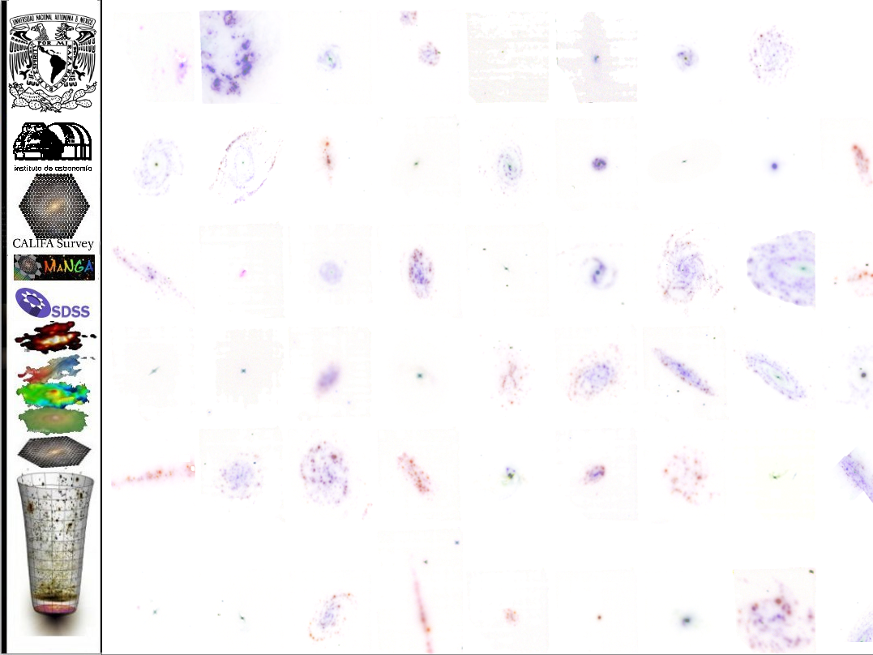
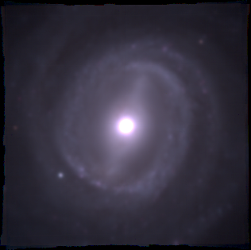
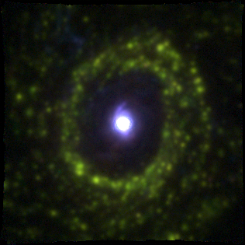
Spatially Resolved Spectroscopic Properties of Low-Redshift Star-Forming Galaxies
Sebastián F. Sánchez –IA/UNAM
IA-UNAM Colloquio
- September 2019-

Slide 2
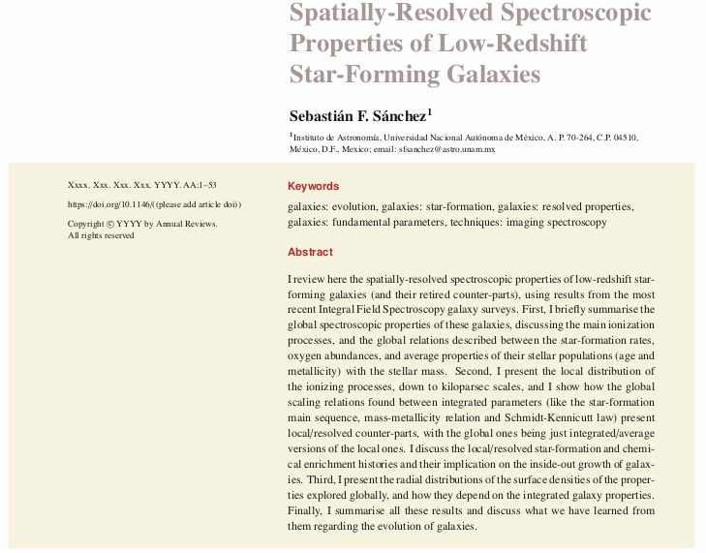
Annual Review of Astronomy
&
Astrophysics
Submitted...
Spatially Resolved Spectroscopic Properties of Low-Redshift Star-Forming Galaxies
Sebastián F. Sánchez –IA/UNAM
IA-UNAM Colloquio
- September 2019-

Slide 3
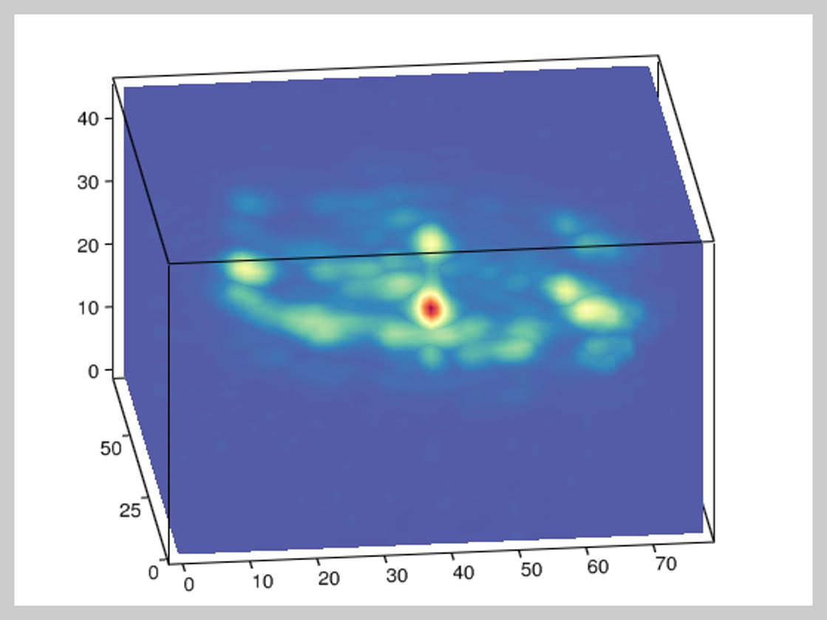
Integral Field Spectroscopy
Integral field spectroscopy (IFS), is the technique that allows us to obtain simultaneously several spectra (within a defined field-of-view, FoV) of a quasi-continuous region in the sky. The final data, after reduction, consist either of a spatially continuous distribution of spectra (3D cube), or a set of individual spectra arranged across the FoV in certain fixed positions.

Slide 4
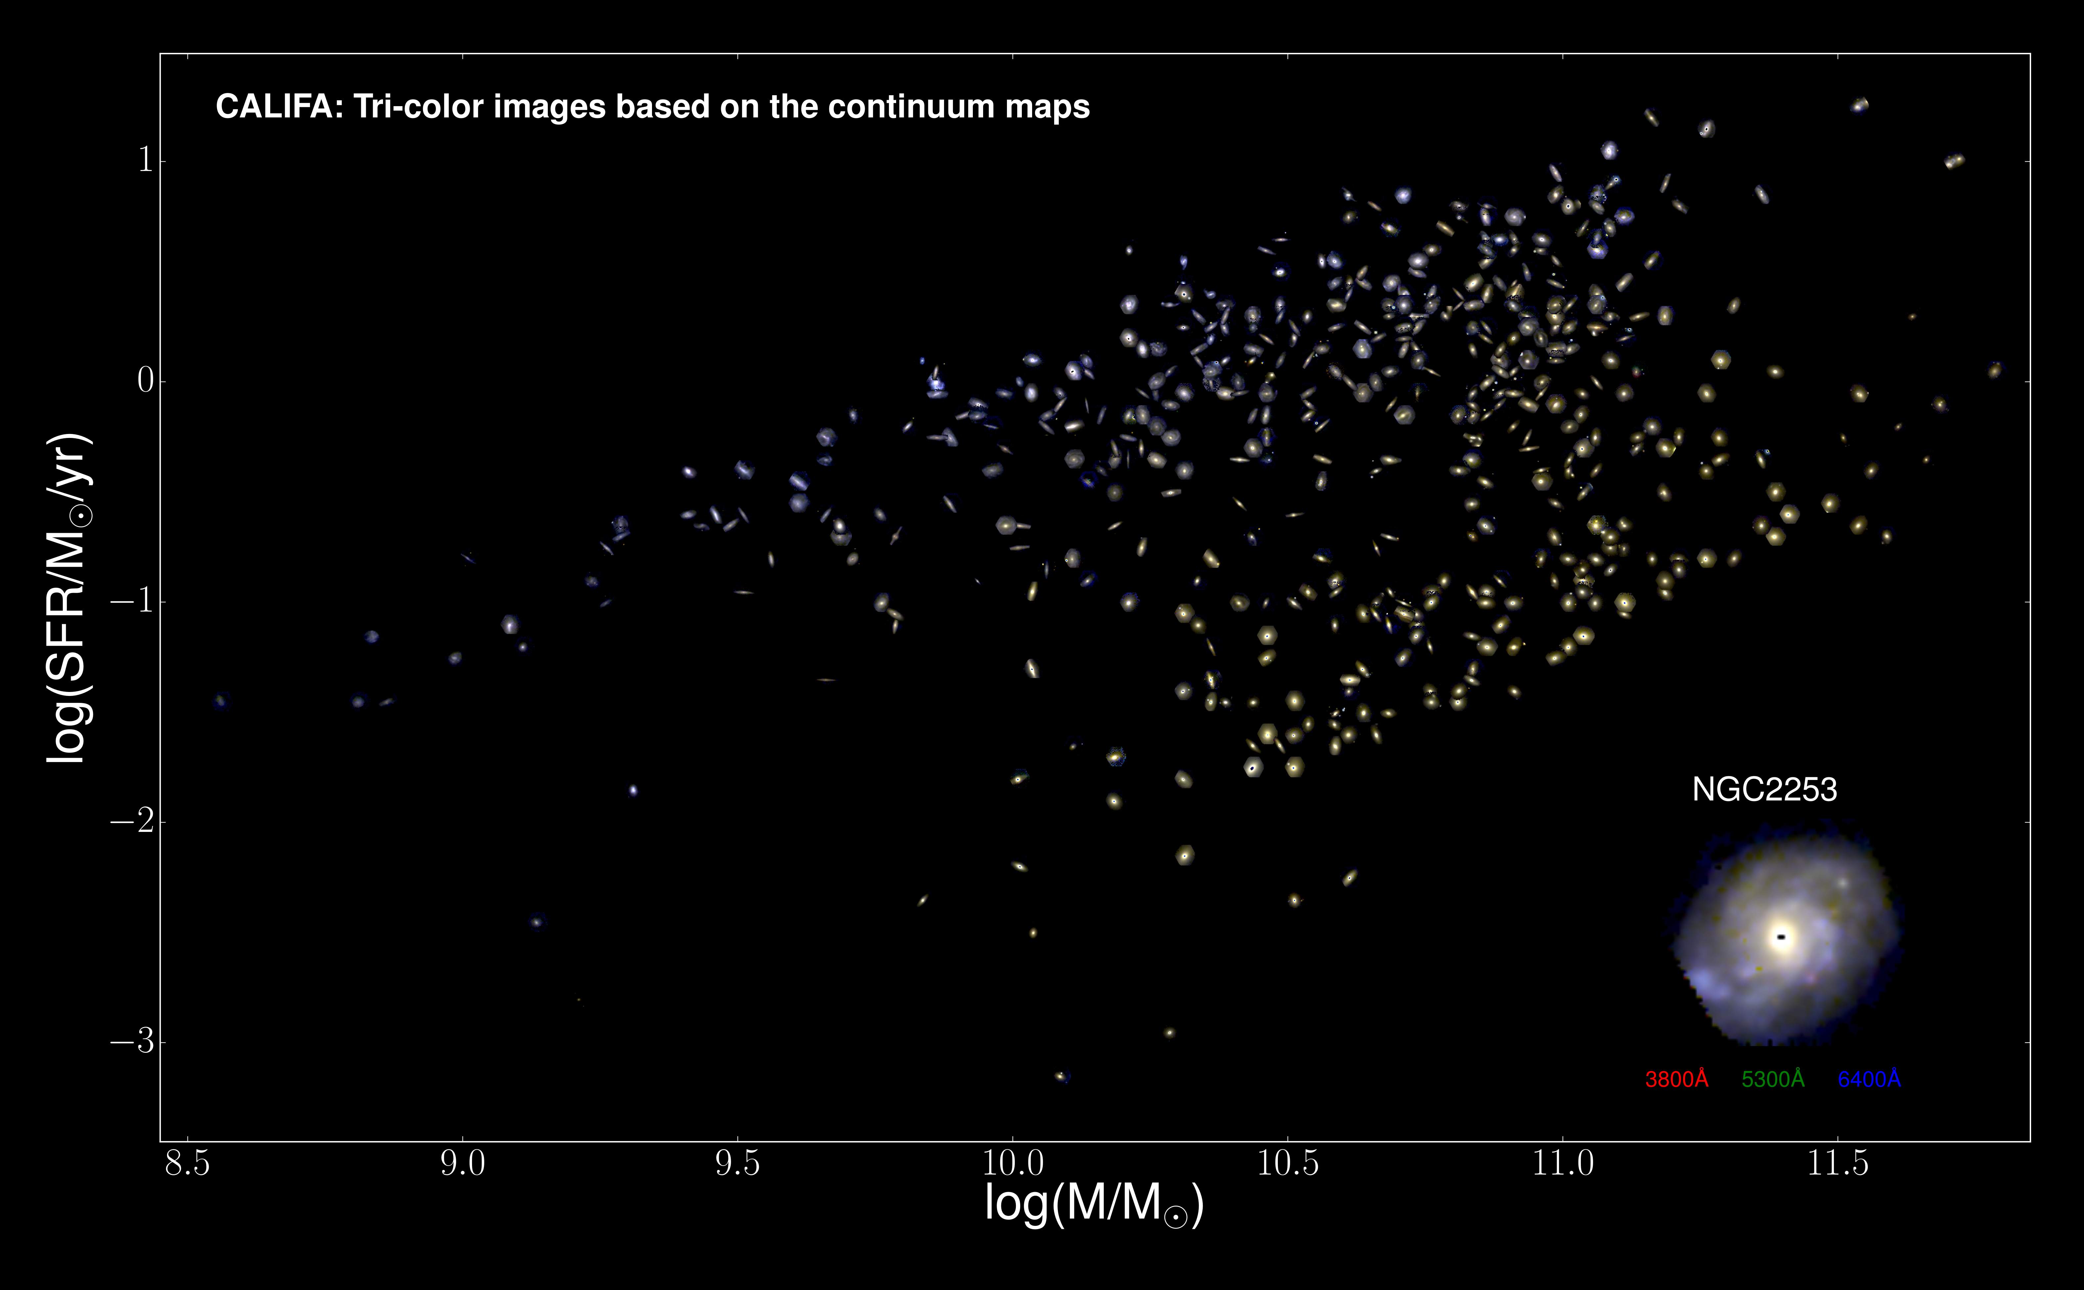
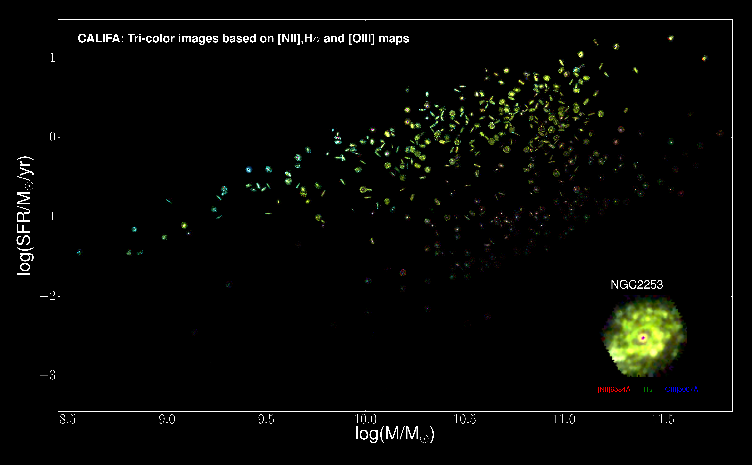
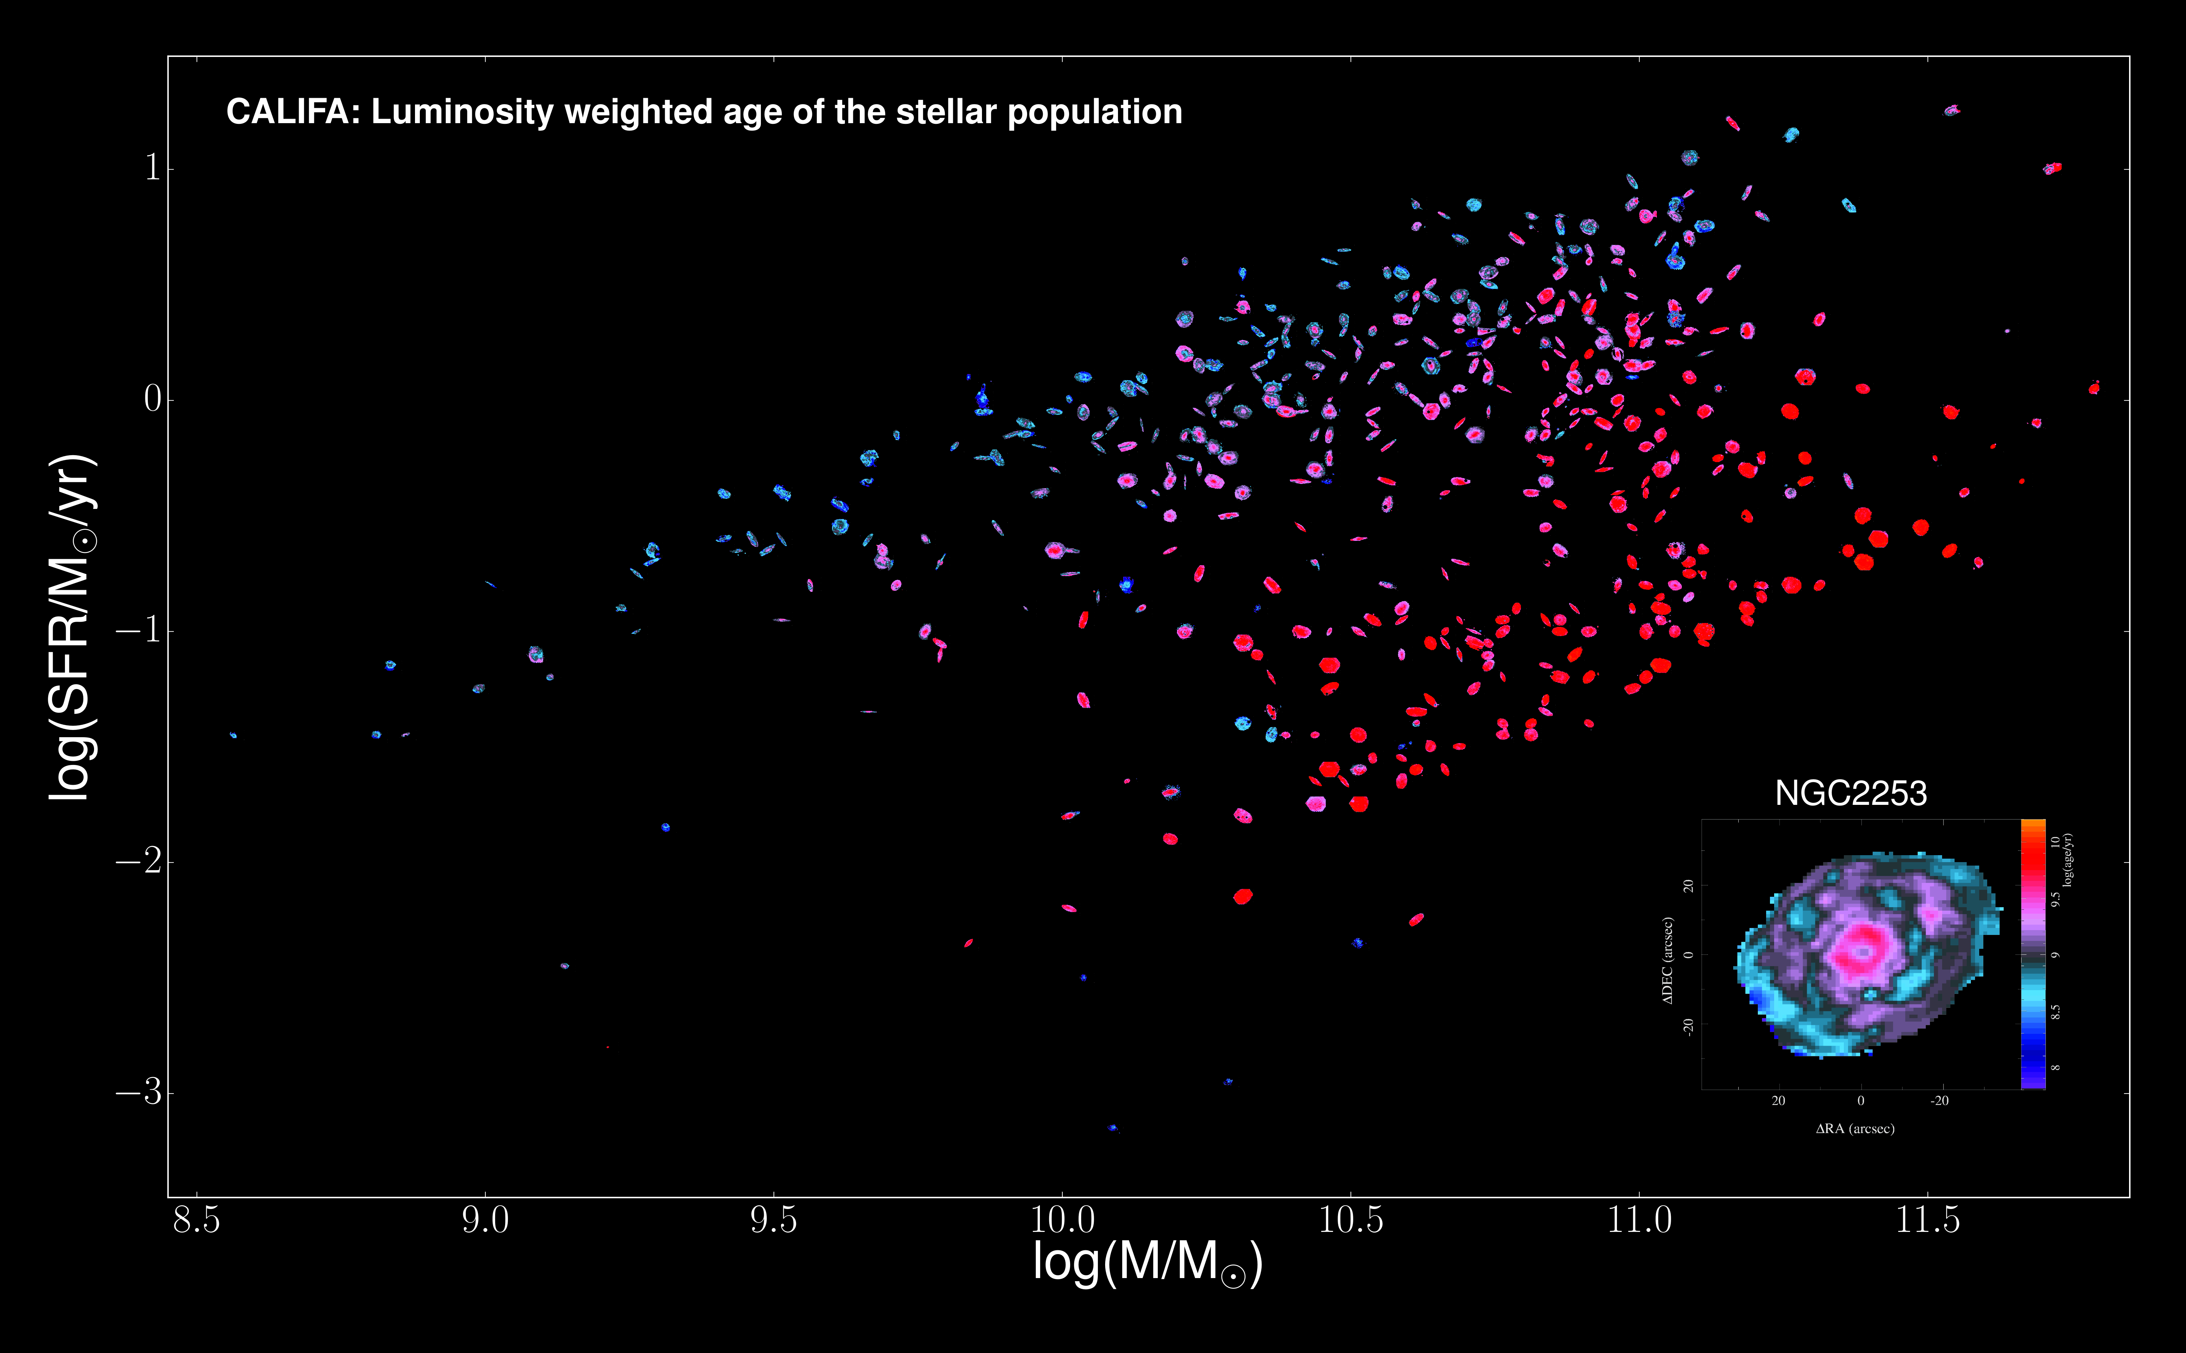
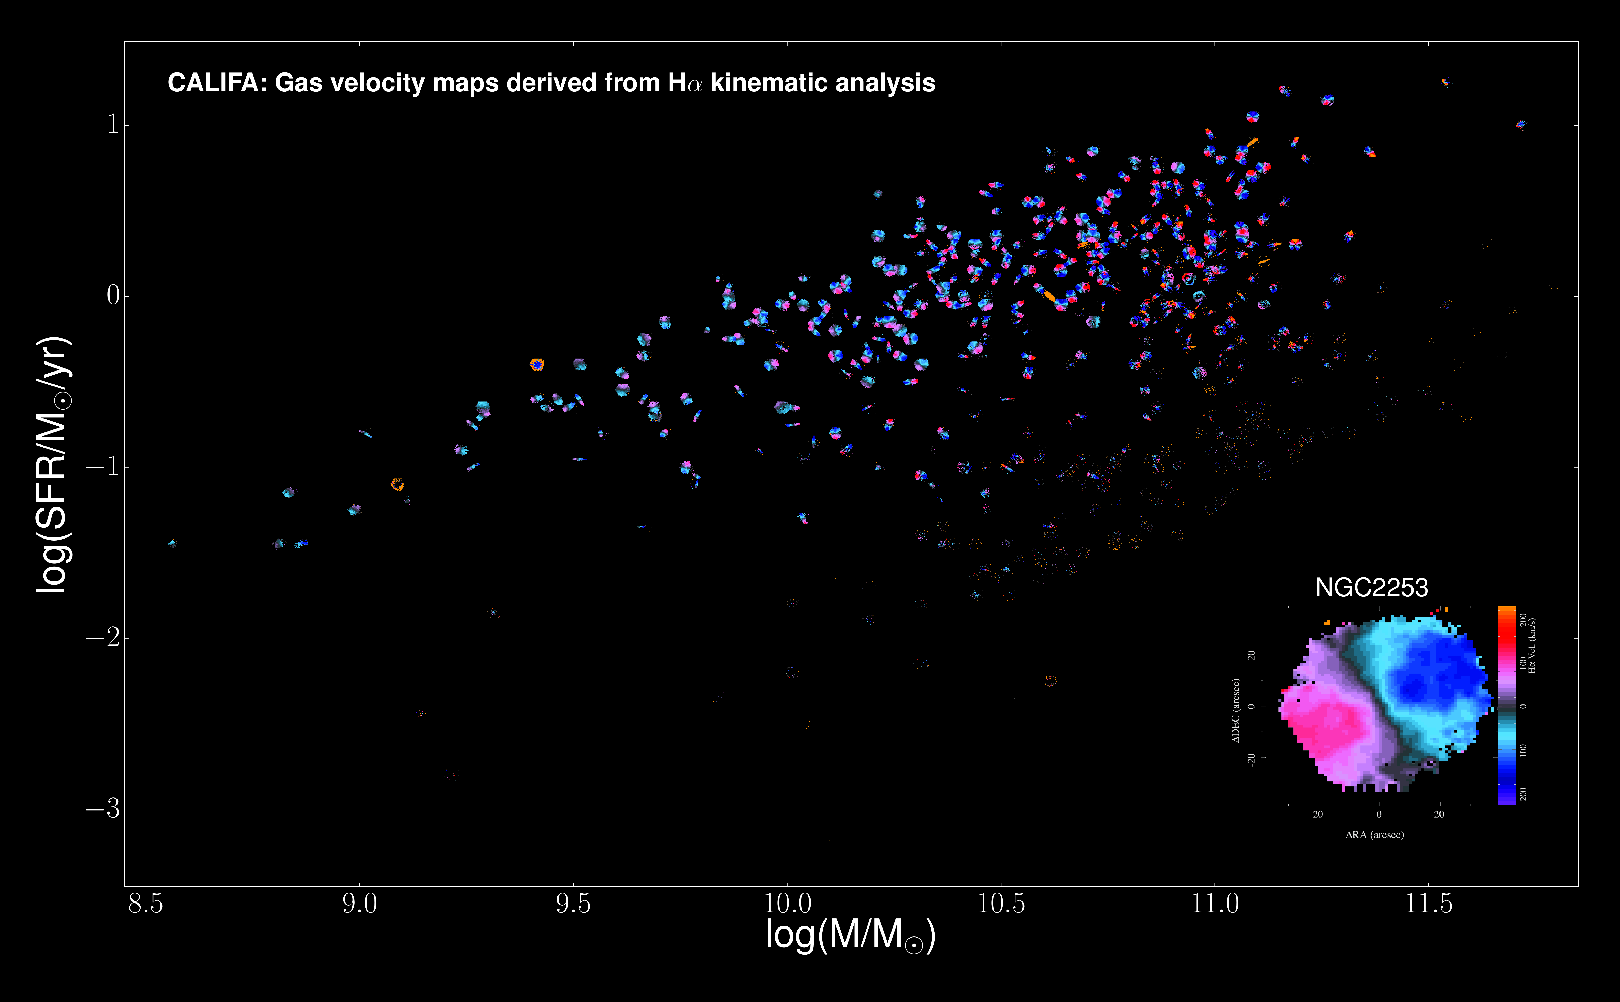
IFS Galaxy Surveys: (i) cover a large fraction of the optical extension of each galaxy; (ii) large/representative samples, (iii) stellar population analysis, (iv) ionized gas content, (v) kinematics and dynamics.
Only possible with dedicated pipelines: Pipe3D (CALIFA, MaNGA, SAMI and AMUSING++), DAP (MaNGA), Firefly (MaNGA), PyCASSO (CALIFA), LZIFU (SAMI)...

Slide 5
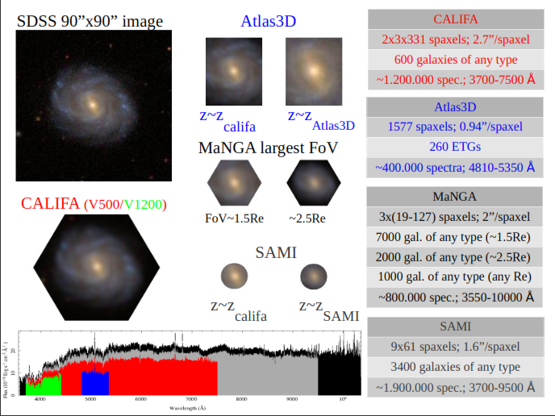
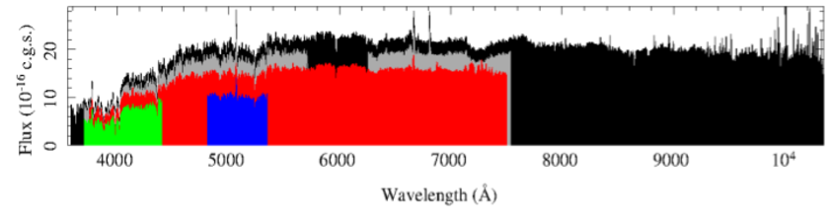
e
AMUSING++
974
AMUSING ++
MUSE: 90000 spaxels, 0.2”/spax
Compilation of 540 galaxies
~40M spec. 4650-9300 AA
(AMUSING,MAD, TIMER,GASP...)
IFS Galaxy Surveys

Slide 6
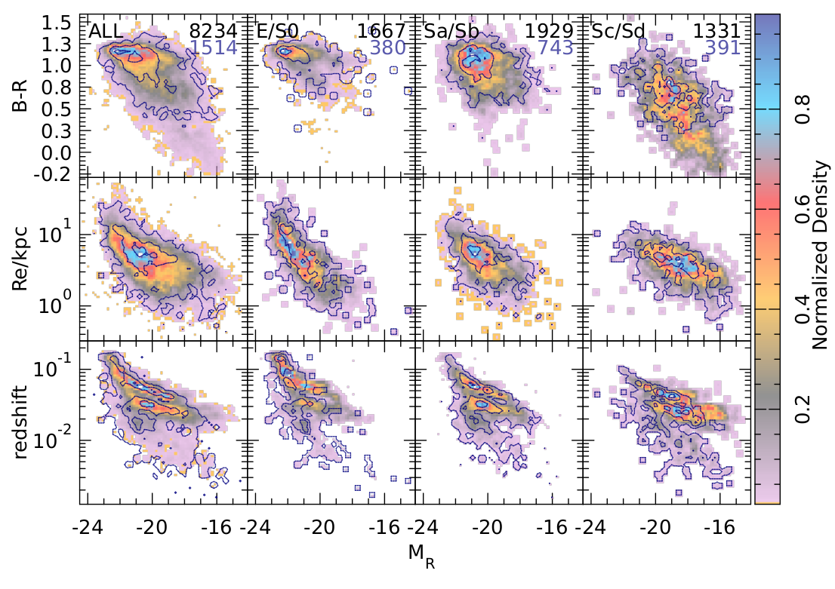
Global & Local Properties of Galaxies
I adopted a compilation of publically available IFS data from different galaxy surveys (CALIFA, MaNGA, SAMI) and archive observations (AMUSING++). It comprises ~8,000 galaxies/datacubes. Resambles a representative sample of galaxies in the nearby universe (z<0.1).

Slide 7
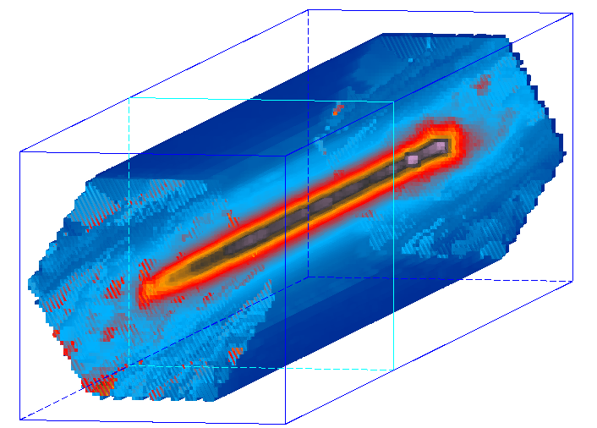
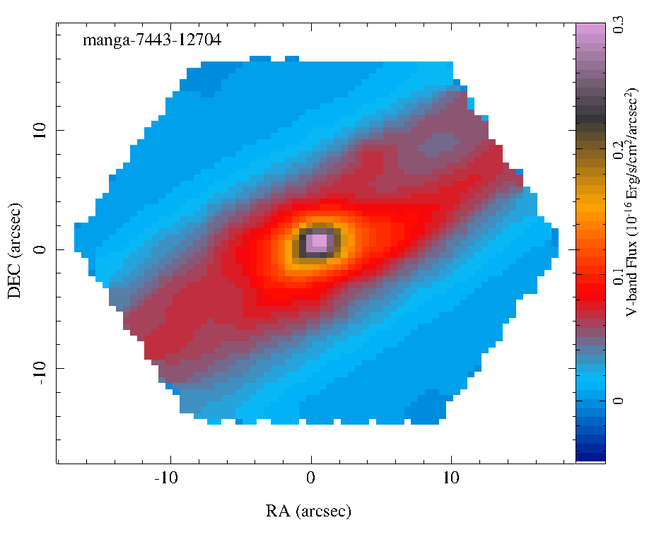
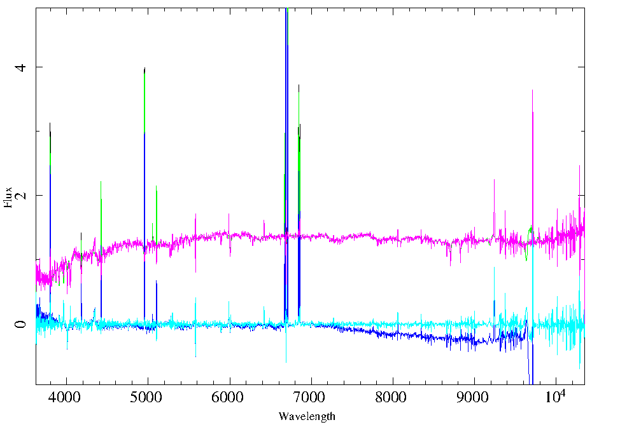
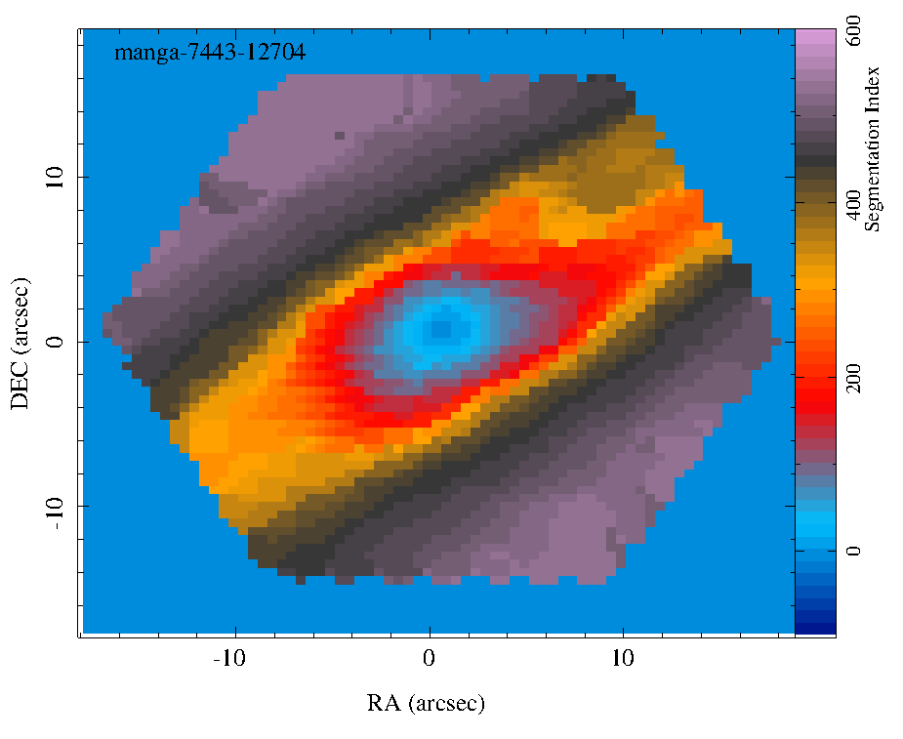
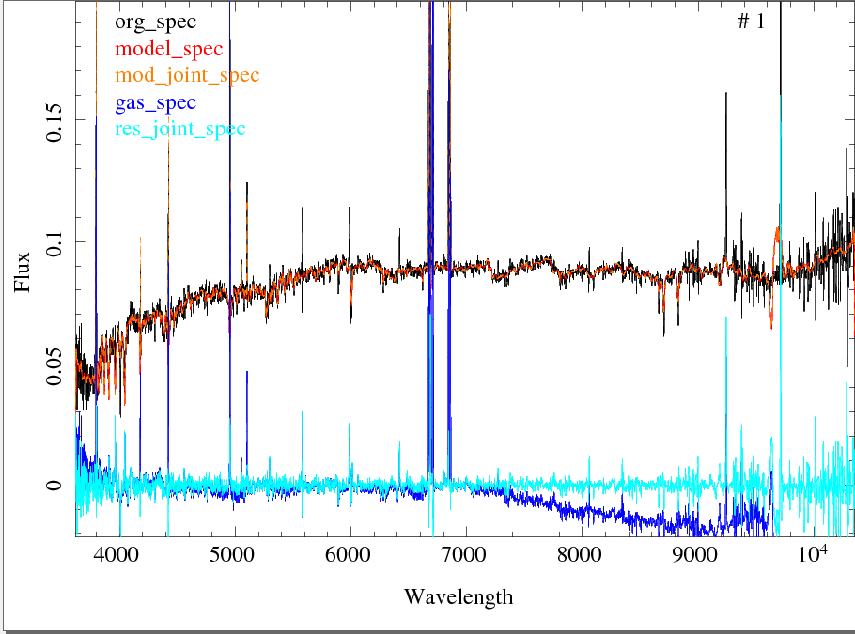
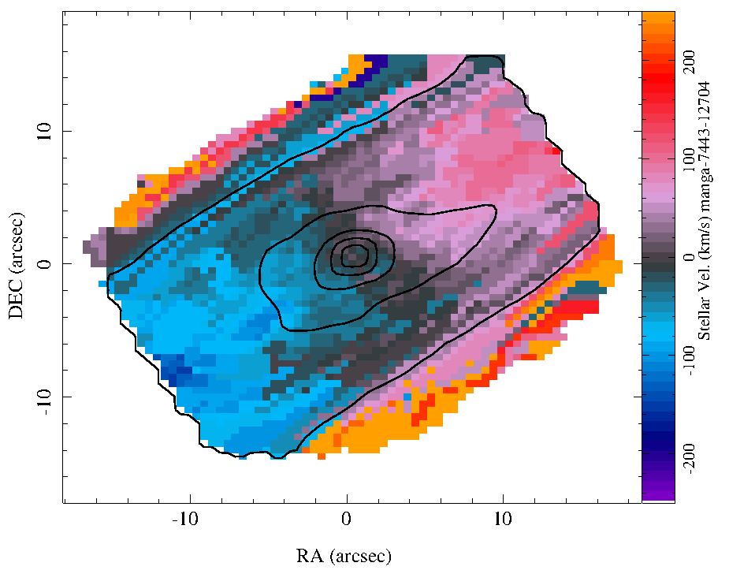
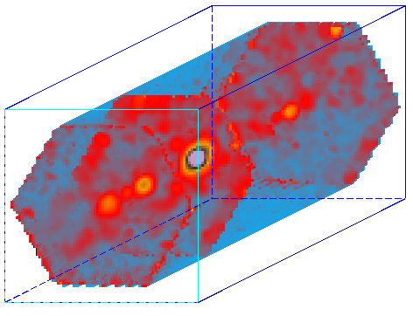
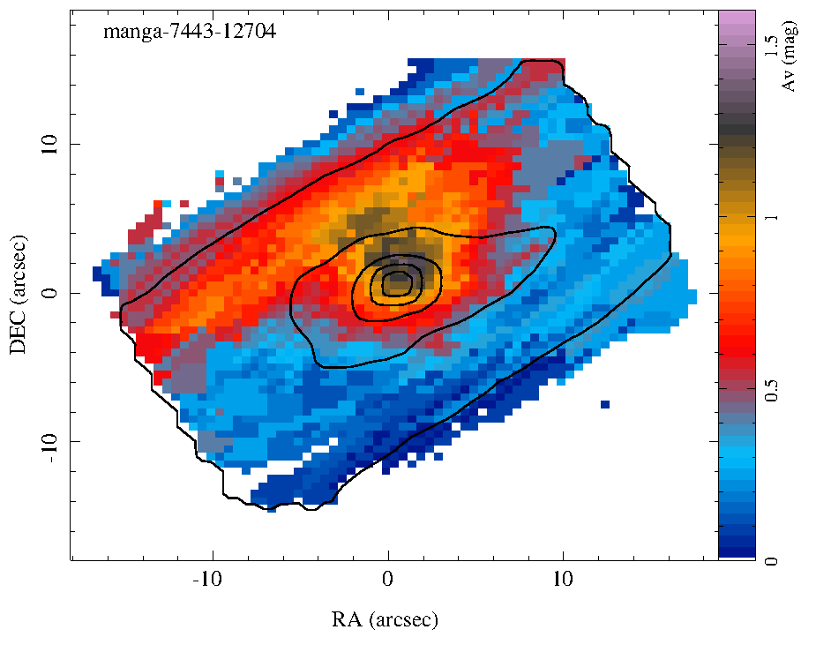
Datacube
- Sys. Vel. - σ_{cen} - Range of param.
Pipe3D: An IFS analysis pipeline for MaNGA, CALIFA, SAMI, and MUSE
Broad-band + S/N
Central Aperture+FIT3D+small SSP template (6 SSPs)+Strong Em. lines
- St. Vel. map. - St. σ map. - St. Av map. (Cardielli et al. 1998, curve)
RSS+FIT3D+small SSP template (12 miuscat SSPs 3600-9500 AA)+Strong Em. Lines
Gas “cleaned” datacube RSS-segmented FIT3D+large SSP template (156 SSPs 3600-7200 AA) SFH, Age, [Z/H], St. Mass
Gas pure Datacube → Analysis of the strong and weak emission lines
Sanchez et al., 2016, RMxAA, 52, 171

Slide 8
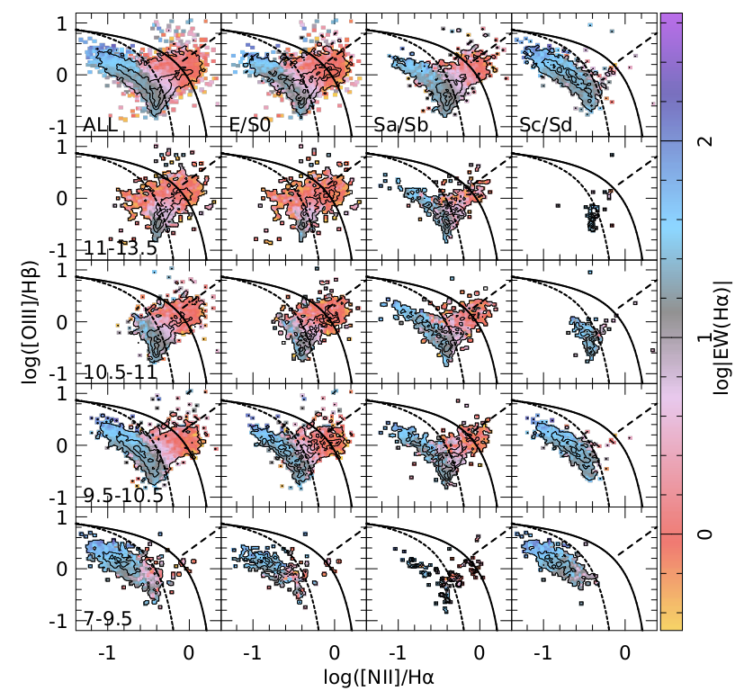
Global Properties of Galaxies
Dominant ionizating source depends on M* and morphology: (I) SF dominates in late-type, less massive galaxies (e.g, Kauffmann et al. 2003; Lacerda et al. 2018), (ii) post-AGB ionization (LINER-like) dominates in early-type (Signh et al. 2013; Gomes et al. 2016), more massive galaxies (Stashinska et al. 2008; Cid Fernandes et al. 2010), (iii) AGN are hosted mostly in early-type spirals ( Schawinski et al. 2010; Sánchez et al. 2019).

Slide 9
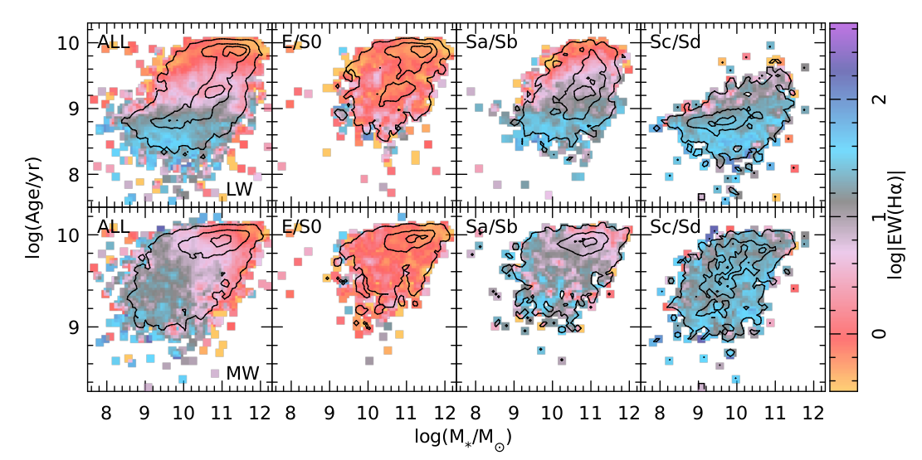
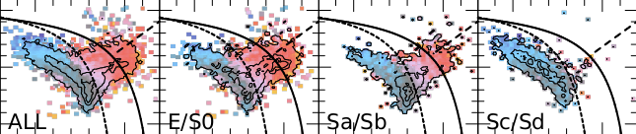
Global Properties of Galaxies - bimodality -
Large (spectroscopic/imaging) surveys have allowed to explore the evolution of galaxies using large samples, statistically well defined (SDSS, York et al. 2000; GAMA, Driver et al. 2009) . Galaxies present a clear bimodality that depends on the morphology and the mass.

Slide 10
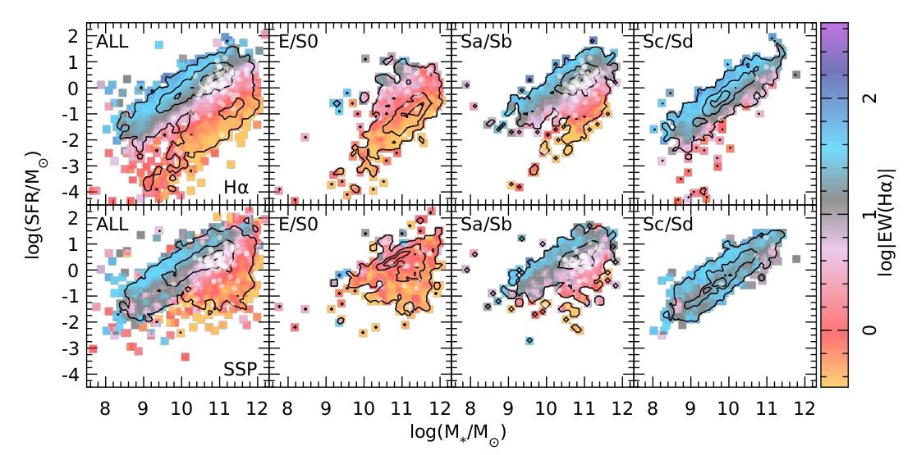
Global Properties of Galaxies - bimodality -
SFGs/RGs segregates pretty well along the SFR-M* diagram. SFGs follow a well defined sequence (SFMS; Renzini & Peng 2015), that evolves with time (Speagle et al. 2014; Sánchez et al. 2019). There should be a fast transition between SFGs and RGs (lack of GVGs). AGNs are mostly in the GV (Kauffman et al., 2003; Schawinski et al. 2010)

Slide 11
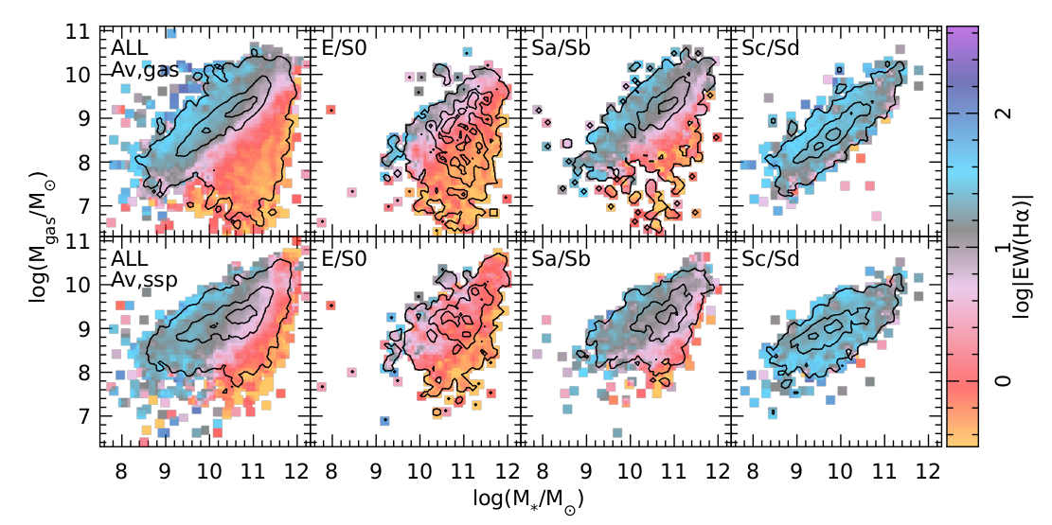
Global Properties of Galaxies - bimodality -
Galaxies halt SF primarily due to a lack of (molecular) gas, that affects mostly to early-type galaxies (e.g. Saintoinge et al. 2011; Calette et al. 2019). However, depletion time (SFE) changes along M* and the morphological type (e.g., Davies et al. 2014; Colombo et al. 2014).

Slide 12
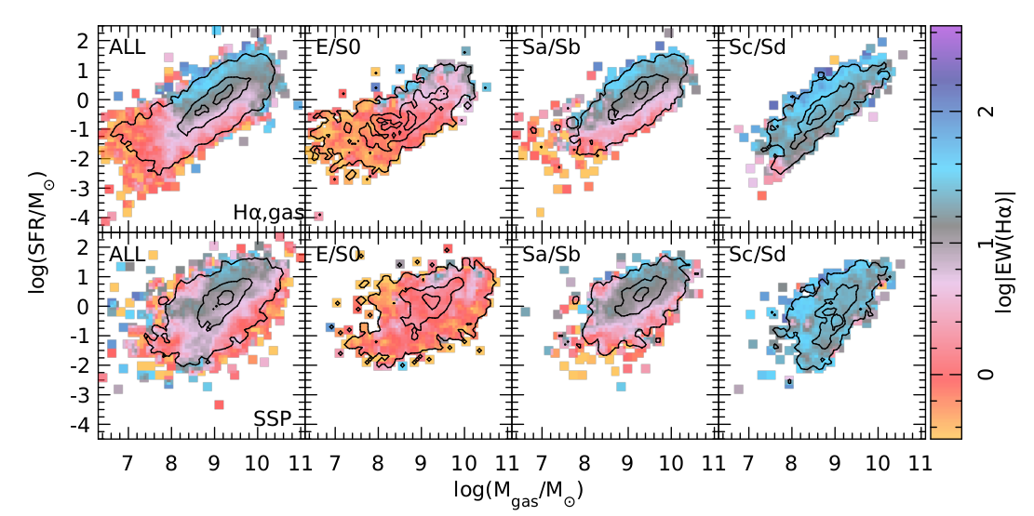
Global Properties of Galaxies - bimodality -
Galaxies halt SF primarily due to a lack of (molecular) gas, that affects mostly to early-type galaxies (e.g. Saintoinge et al. 2011; Calette et al. 2019). However, depletion time (τ=SFE⁻¹; SFE=SFR/M_{gas}) changes along M* and the morphological type (e.g., Davies et al. 2014; Colombo et al. 2014).

Slide 13
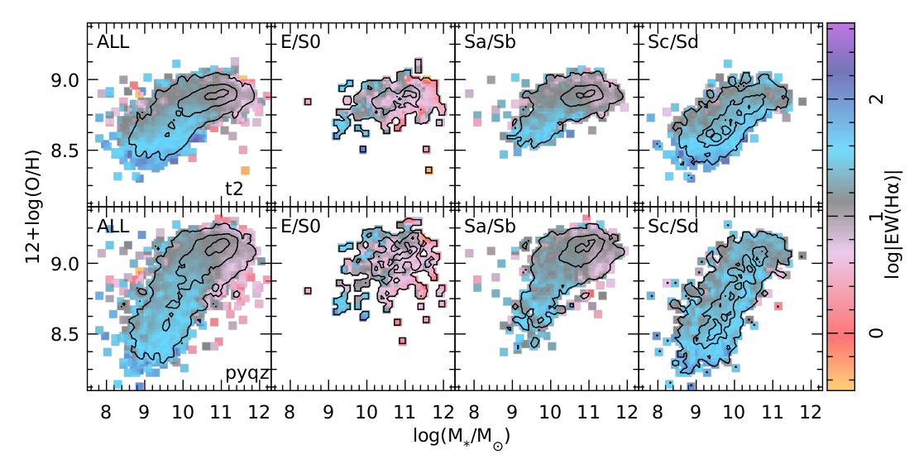
Global Properties of Galaxies - Scaling relations -
Star-forming galaxies present different scaling relations: (1) SFMS (SFR-M*); (2) SK-law (SFR-Mgas); (3) Mass-Metallicity relation (MZR, Tremonti et al. 2004). The MZR is not lineal. It presents two regimes, a lineal one (M*<10^{9.5} M☉) and a plateau (M*~10¹¹ M☉): Outflows/inflows equilibrium?

Slide 14
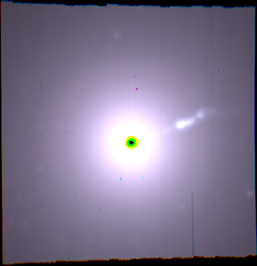
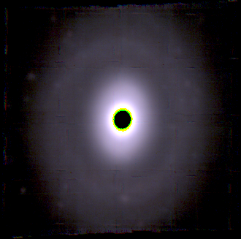
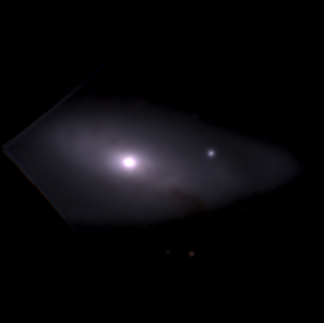
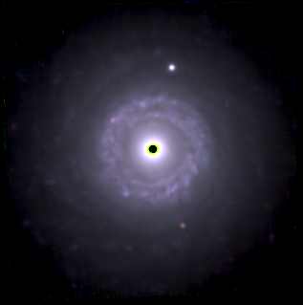
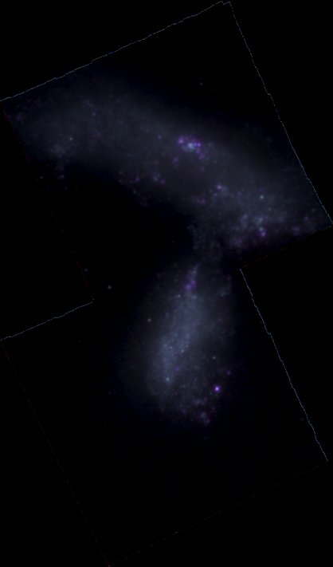
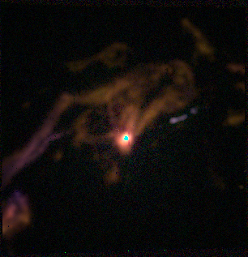
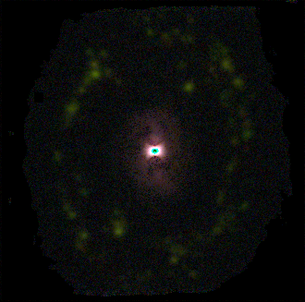
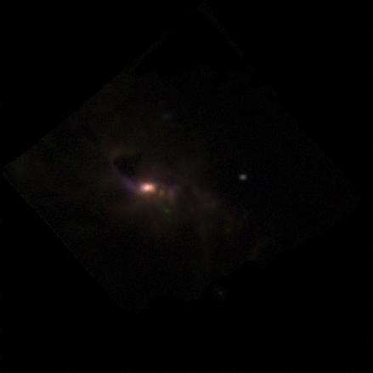
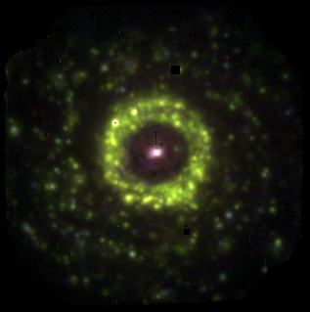
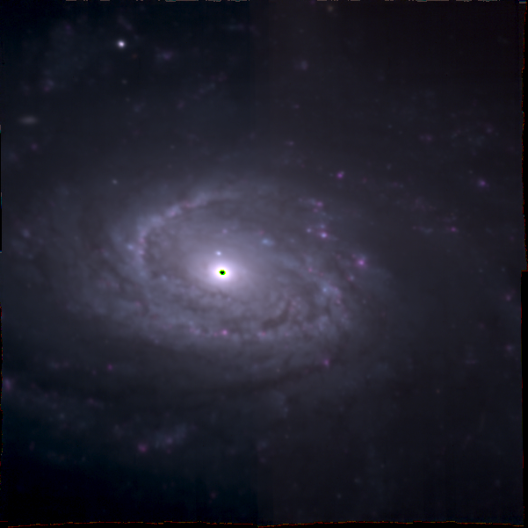
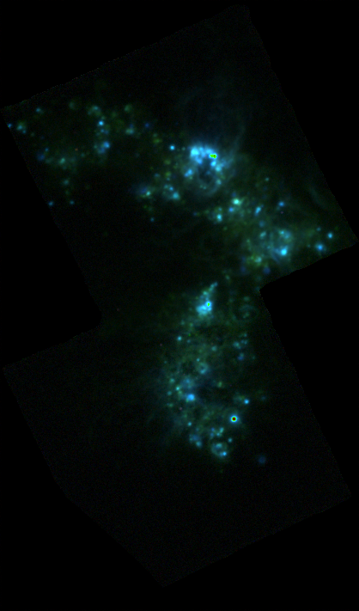
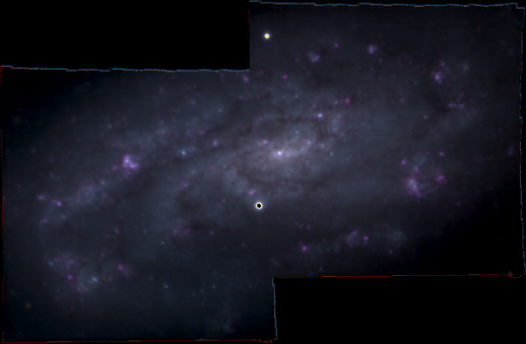
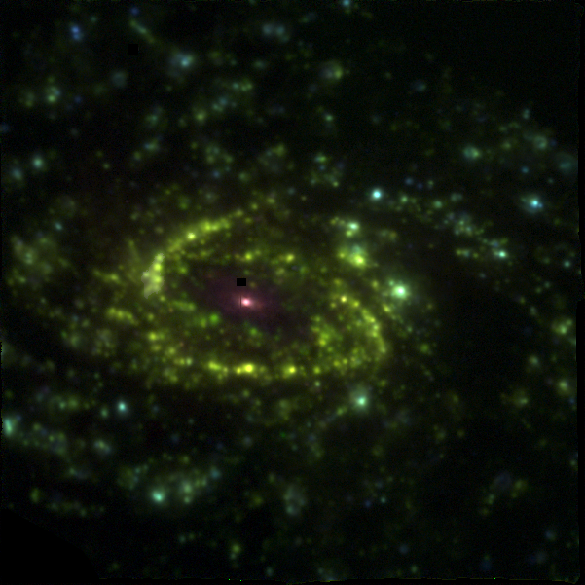
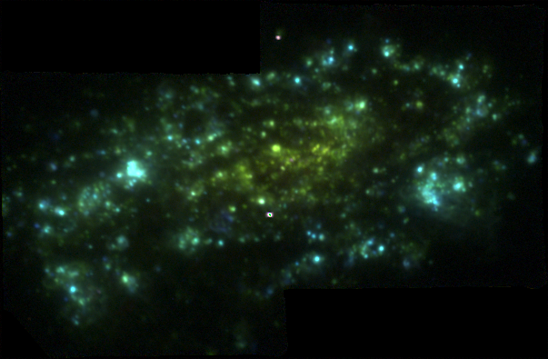
However, galaxies are resolved objects: SF, ionization, metal recycle are local processes, not global ones.
Are the scaling relations local or global?
At which scales are still verified?
What they tell us about the evolution in galaxies?
IFS is required!!!
S0
Sb
Elliptical
S0
Sa
Irregular
The Hubble
Sequence
Observed
By AMUSING
(PI: J. Anderson,
Galbany
et al. 2016)
Top: B,R,I colour
image,showing
the stelllar
populations.
Bottom: [OIII] (B),
Ha (G), [NII] (R ),
showing
the ionized gas.
Sc
Sd

Slide 15
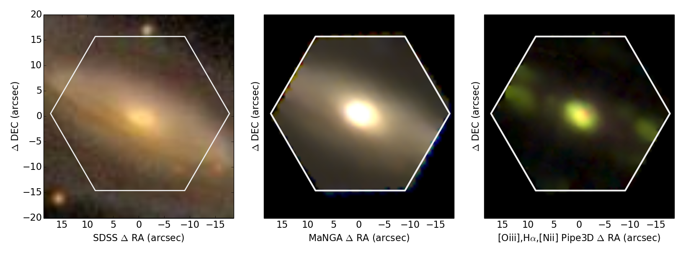
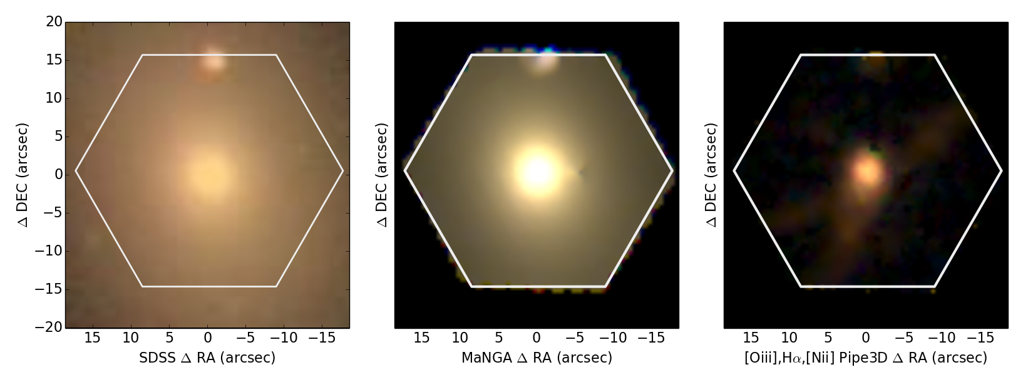
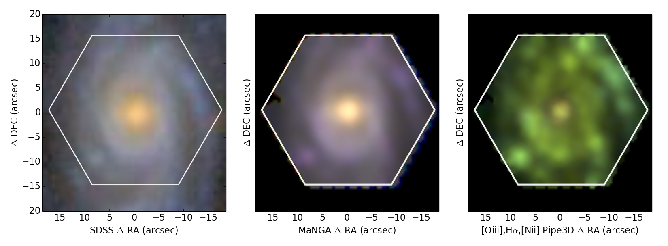
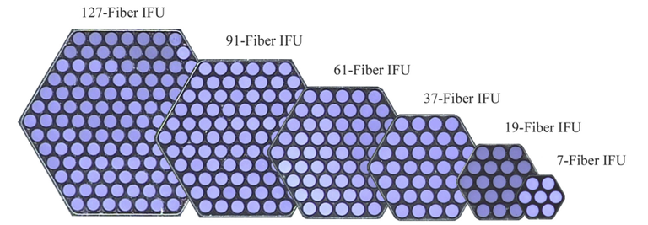
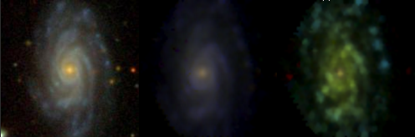
Not all IFS Galaxy Surveys provides the same information!
MaNGA (largest bundle)
CALIFA

Slide 16
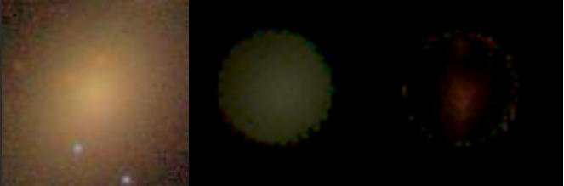
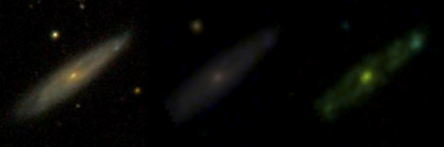
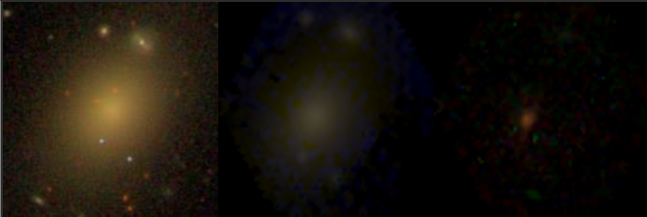
INot all IFS Galaxy Surveys provides the same information!
SAMI
CALIFA

Slide 17
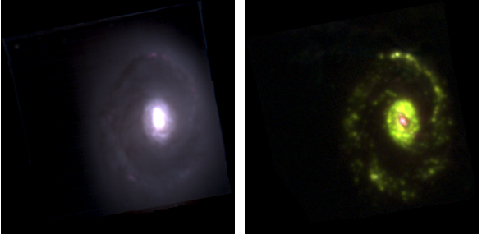

Not all IFS Galaxy Surveys provides the same information!
MUSE
CALIFA

Slide 18

Gas is ionized by local processes
MUSE
SNR
Off-center,
point-like,
EWα>3Å
SF
AGN
Centred,
point-like,
EWα>3Å
SF
pAGBs?
Ubiquitious,
diffuse,
EWα<3Å
SF
Ionization associated with SF (OB stars) is always clumpy with EWα>>3A

Slide 19

Gas is ionized by local processes
MUSE
pAGBs
Ubiquitious,
diffuse,
EWα<3Å
pAGBs
Shocks
Filaments,
Any EWα
Shocks
Shocks
Outflow,
biconical,
EWα>3Å
SF
Ionization associated with SF (OB stars) is always clumpy with EWα>>3Å

Slide 20

Ionized gas: Local vs Global patterns
AGNs
ALL
E/S0
Sa/Sb
Sc/Sd
High M*
e.g., Lacerda et al. 2018
Morisset et al. 2016
pAGBs
Low M*
SF
CALIFA, MaNGA,SAMI & AMUSING++
~8000 galaxies, ~30M spectra

Slide 21


SFGs
Ionized Gas: SFAs vs RAs rSFMS or Σ*- Σ_{SFR} relation Sánchez et al. 2013 (z=0.01), Wuyts et al al. 2013 (z~0.7) Cano-Diaz et al. 2016; Hsieh et al. 2017; Ellison et al. 2018; Bulck in prep. SFAs (EWα>6Å) at kpcs scales follow a tight relation that depends slightly on the morphology, and less on the mass, and segregate them clearly from RAs (EWα<6Å). The SFMS is local!
RGs
SFAs
RAs
CALIFA, MaNGA,SAMI & AMUSING++
~8000 galaxies, ~30M spectra

Slide 22


Ionized Gas: SK-law Kennicutt et al. 1998 Bolatto et al. 2017; Utomo et al. 2017; Colombo et al. 2018 The SK-law is verified at a kpc scales for the SFAs. RAs depart only slightly from the SK-law. They present a lower amount of (molecular) gas, but only a slightly lower SFE. Quenching is primarely driven by lack of gas, followed by efficiency!
CALIFA, MaNGA,SAMI & AMUSING++

Slide 23


Ionized Gas: local enrichment rMZR or Σ*- O/H relation Rosales-Ortega et al. 2012, Moran et al. 2012; Sánchez et al. 2013; Barrera-Ballesteros et al. 2016 SF Areas at kpcs scales follow a tight relation with the oxygen abundance, with a similar shape to that of the global MZR. The MZR is local!
CALIFA, MaNGA,SAMI & AMUSING++

Slide 24


Stellar populations: local Age-M* bimodality Blanton et al. 2009; Zibetti et al. 2017; Sanchez et al. In prep. RAs in any galaxy is dominated by old stellar populations, while SFAs are dominated by young ones, irrespectively of the global properties of galaxies. Bimodality is local, thus SF and Quenching are local proccesses!
CALIFA, MaNGA,SAMI & AMUSING++

Slide 25

Stellar populations: Σ* gradients Bell et al. 2000; Kauffmann et al. 2003; Bakos et al. 2009 Gonzalez-Delgado et al. 2014; Sanchez et al. 2018 Σ* is a fundamental parameter to understand the local evolution in galaxies. In all galaxies it presents a negative gradient that it is steeper in the inner (bulge-dominated) region. In essence it follows the gravitational potential.
Slope is very similar when normalized by the Re (GD14)
CALIFA, MaNGA,SAMI & AMUSING++

Slide 26

Stellar populations: Age gradients Gonzalez-Delgado et al. 2014; Sánchez-Blazquez et al. 2014; Li et al. 2015; Goddard et al. 2015 All galaxies present a negative Age gradient, with older stellar populations in the central regions and younger in the outer ones (Goddard et al found somehow different results). Evidence for an inside-out growth
Slope is very similar when normalized by the Re (GD14)
CALIFA, MaNGA,SAMI & AMUSING++

Slide 27

Stellar populations: [Z/H] gradients Gonzalez-Delgado et al. 2014; Sánchez-Blazquez et al. 2014; Goddard et al. 2015 Massive/earlier-type galaxies present a negative [Z/H] gradient, with more metal rich populations in the ceentral regions (Goddard et al found somehow different results). Less massive/later-type galaxies present an inversion in the gradient. Despite of inside-out, ChEs and SFHs change with M* and morphology.
CALIFA, MaNGA,SAMI & AMUSING++

Slide 28

Ionized gas by OB-stars: O/H gradients Searly et al. 1973; Peimbert et al. 1978; Vila Costas et al. 1992; Sánchez et al. 2014; Sánchez-Menguiano et al. 2016; Belfiore et al. 2017; Sánchez-Menguiano et al. 2018; Galaxies more massive than 10^{9.5} M☉ present a similar oxygen abundance gradient between 0.5-2.0 Re. Along the disk the oxygen is following the mass growth through the rMZR. Inside-out differential [α/Fe] changing by M* and morphology.
Low statistics!
CALIFA, MaNGA,SAMI & AMUSING++

Slide 29




Stellar populations: Inside-out mass growth Panther et al. 2007; Perez et al. 2013; Ibarra-Medel et al. 2016; Garcia-Benito et al. 2017; López-Fernández et al. 2018; Sánchez et al. 2019 Galaxies with M*>10^{9.5} M☉ present a clear inside-out growth, that it is stronger for more massive and earlier-type galaxies.
f* @ z=1
f* @ z=1

Slide 30

Stellar populations and ionized gas: Σ_{SFR} gradients Gonzalez-Delgado et al. 2016; Belfiore et al. 2017; Ellison et al. 2018; Sanchez et al. 2018 Σ_{SFR} follows primarely Σ* in all galaxies (rSFMS), showing a peak in the central regions and a steady decrease towards the outer regions.
CALIFA, MaNGA,SAMI & AMUSING++

Slide 31

Stellar populations and ionized gas: sSFR gradients Gonzalez-Delgado et al. 2016; Belfiore et al. 2017b; Ellison et al. 2018; Sanchez et al. 2018; Cano-Diaz et al., submitted. sSFR presents a decline with M* and mophology. In addition, there is a decline in the central regions, associated with the bulge, where SF has stoped. Qhenching evolves from the inside-out!
CALIFA, MaNGA,SAMI & AMUSING++

Slide 32

Stellar populations and ionized gas: SFE gradients Utomo et al. 17; Colombo et al. 2018; Sanchez et al. 2018b Central quenching is due primarily by a lack of (molecular) gas. However, there is also a decrease (increase) of the SFE (deplection time).
CALIFA, MaNGA,SAMI & AMUSING++

Slide 33
Conclusions Sanchez et al., ARAA, submitted
- IFS-GS have improved our understanding of the physical processes that shaped galaxies along their cosmological evolution. - Ionization is a local process, and the nature and properties of ionized gas can only be derived exploring not only line ratios, but the nature of the underlying stellar population and the morphology of the ionized structures. - The evolution of galaxies is ruled by local (resolved) relations that link many observed properties with the Σ* (Σ_{SFR}, Σ_{gas},O/H, Z/H, Age,), that (1) generate most of the radial gradients observed in galaxies, and (2) induce global (integrated) relations, like the SFMS, MZR, SK-law… - The local relations are modified by global properties, like the M* and the Morphology (Dynamical effects?). - Galaxies growth from the inside-out, with SFHs and ChEHs that are sharper in the central regions (of more massive and earlier type galaxies). - Quenching happens from the inside-out, driven by a lack of (molecular) gas, but with a secondary effect induced by a change in the SFE (which strength depends on M* and morph.)

Slide 34

Stellar populations: Σ* gradients Catalan-Torrecilla et al.. 2015, 2017; Lacerda et al. 2018; Sanchez et al. 2018 Strong relation with ionization properties: Bulges are dominated by RAs (pAGB ionization), while disks are dominated by SFAs (OB-stars). However, in the 2nd there is a mix of ionization.
CALIFA, MaNGA,SAMI & AMUSING++
~8500 galaxies, ~30M spectra

